Slide 1




Weekly report: Load & Dynamics
Week number: 08
Date: 18/11/2025
Supervisor: Mr. Manjock
Group members: Md Aman, Arham Memon, Paresh Nakum
Presenter – Md Aman, Arham Memon, Paresh Nakum
18/11/2025
Md Aman, Arham Memon, Paresh Nakum
Optimus Syria

Slide 2
Agenda For Loads & Dynamics
DLC 4.2 Case Simulation - normal stop during extreme operating gust (EOG)
Updated DLC 5.1- emergency stop during normal operation
Updated DLC 6.1 – with different Randseed
Conclusion & Future Plan
Bibliography
18/11/2025
Md Aman, Arham Memon, Paresh Nakum
Load & Dynamics Team/ Optimus Syria

Slide 3
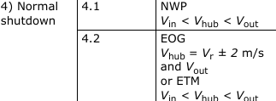
DLC 4.2 Normal Shutdown
DLC 4.2 (Design Load Case 4.2) considers the Extreme Operating Gust (EOG) event, designed to test the turbine's ability to withstand sudden, sharp changes in wind speed while the machine is operating and a normal shutdown is initiated.
Normal Wind Profile
Extreme Operating Gust
WHY 4.2
EOG is critical because the gust suddenly overloads the drivetrain, forcing the pitch controller to maintain stability.
18/11/2025
3
Md Aman, Arham Memon, Paresh Nakum
Load & Dynamics Team/ Optimus Syria

Slide 4
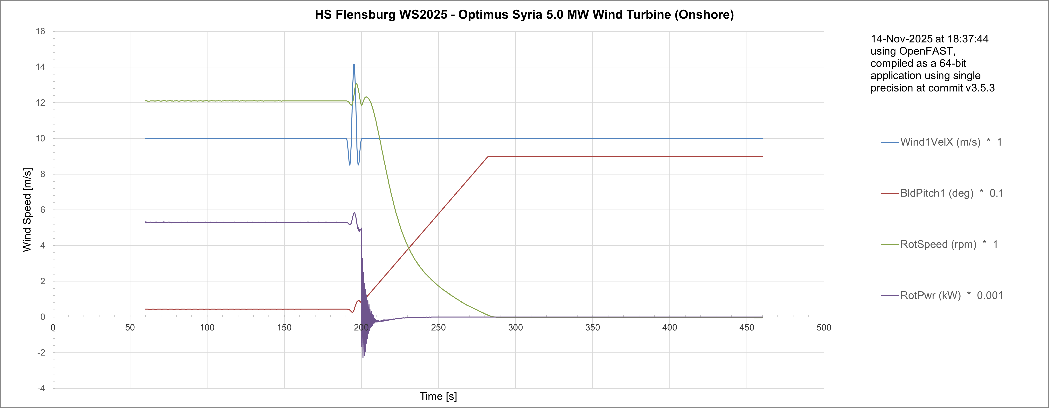
DLC 4.2 Simulation examples
10 m/s
18/11/2025
4
Md Aman, Arham Memon, Paresh Nakum
Load & Dynamics Team/ Optimus Syria

Slide 5
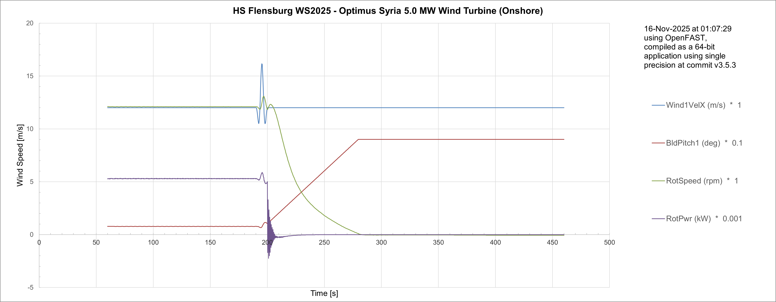
DLC 4.2 Simulation examples
12 m/s
The simulation confirms the controller's robust stability across all operating regimes. The turbine manages the extreme gust by transitioning control: at low speeds 7.5m/s, rotor speed absorbs the load, while at high speeds 10m/s, 12m/s, 25m/s, the pitch controller quickly sheds aerodynamic power. This validates that the system can withstand the maximum transient loading conditions required by this design load case.
18/11/2025
5
Md Aman, Arham Memon, Paresh Nakum
Load & Dynamics Team/ Optimus Syria

Slide 6

DLC 5.1Emergency Stop
This load case covers manual actuation of the emergency stop pushbutton. For this load case, the rotor shall be brought to a standstill as quick as possible.
Normal Turbulence Model
WHY 5.1
DLC 5.1 is used to calculate the maximum loads resulting from a sudden emergency stop, ensuring the turbine's safety systems and structure survive.
18/11/2025
Md Aman, Arham Memon, Paresh Nakum
Load & Dynamics Team/ Optimus Syria

Slide 7
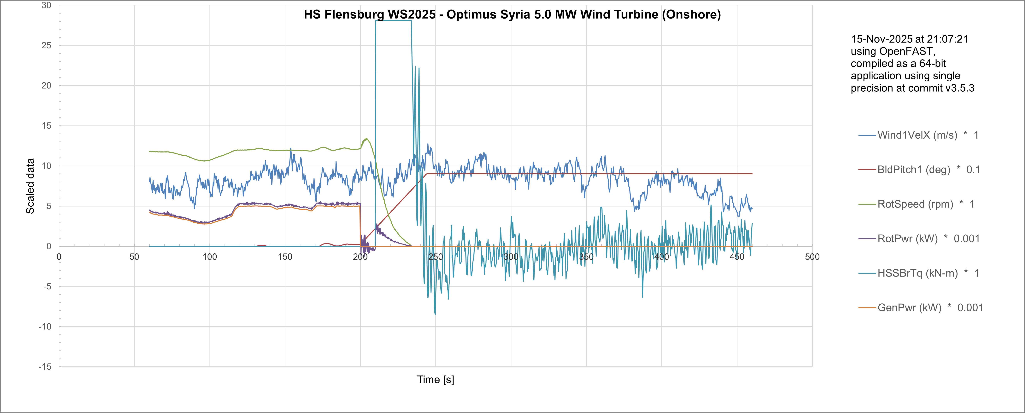
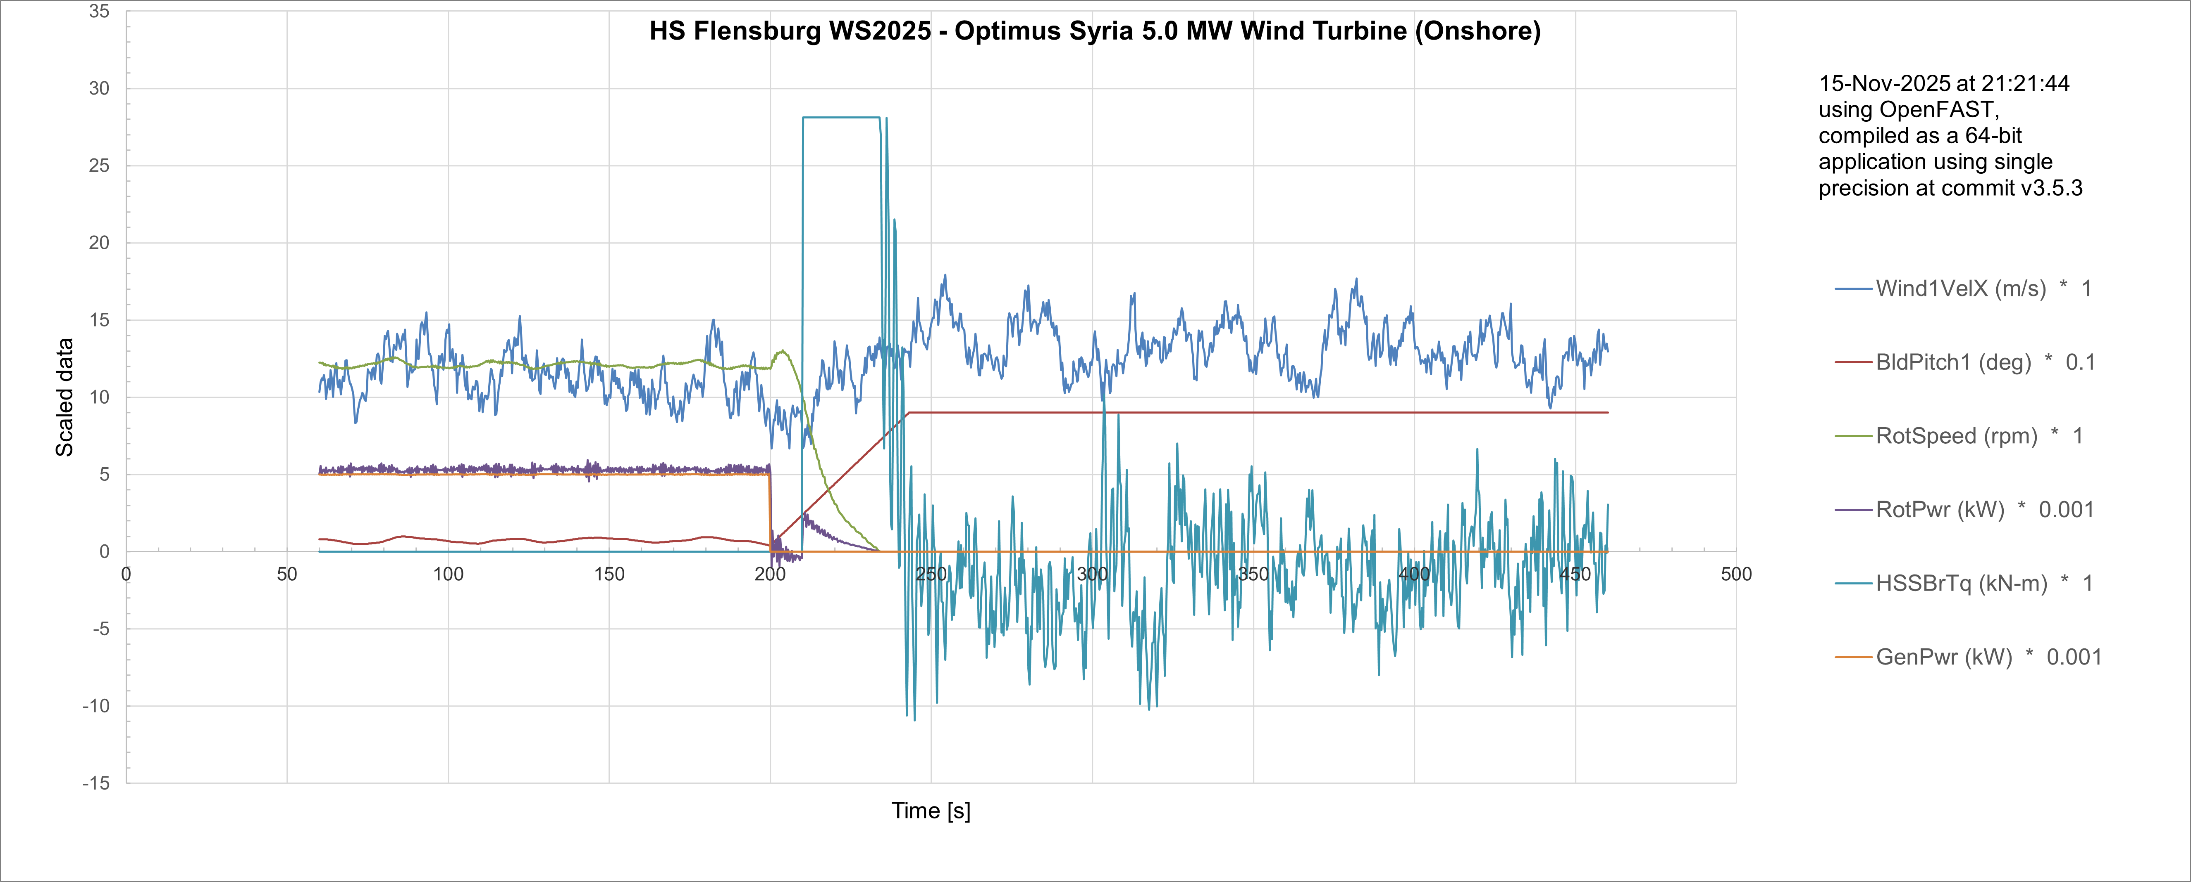
DLC 5.1Emergency Stop
8 m/s
12 m/s
18/11/2025
7
Md Aman, Arham Memon, Paresh Nakum
Load & Dynamics Team/ Optimus Syria

Slide 8
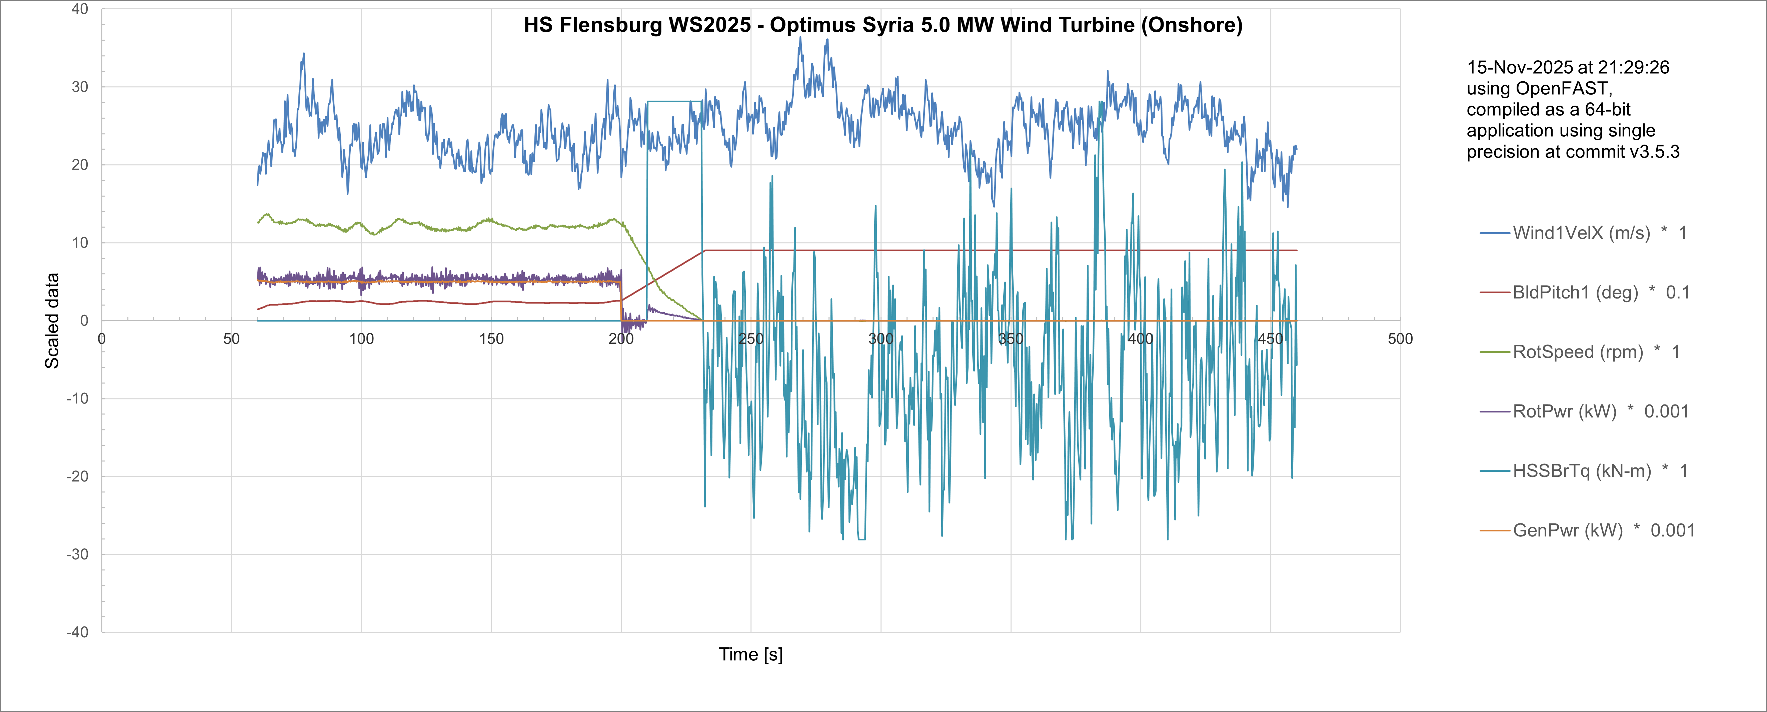
DLC 5.1Emergency Stop
25 m/s
Wind Speed (Vhub​) | Operating Region | HSSBTq Spike (Brake Load) | Pitch Action
8 m/s (Below Rated) | Partial Load | Lowest spike (e.g., ±5 kN-m). | Pitch moves quickly from ≈0∘ to max angle.
12 m/s (Above Rated) | Full Load | Medium spike (e.g., ±10 kN-m). | Pitch moves quickly from ≈1∘ to max angle.
25 m/s (Cut-Out) | Full Load (Maximum) | Highest spike (e.g., ±30 kN-m). | Pitch moves quickly from a high operating angle (≈7∘) to max angle.
18/11/2025
8
Md Aman, Arham Memon, Paresh Nakum
Load & Dynamics Team/ Optimus Syria

Slide 9
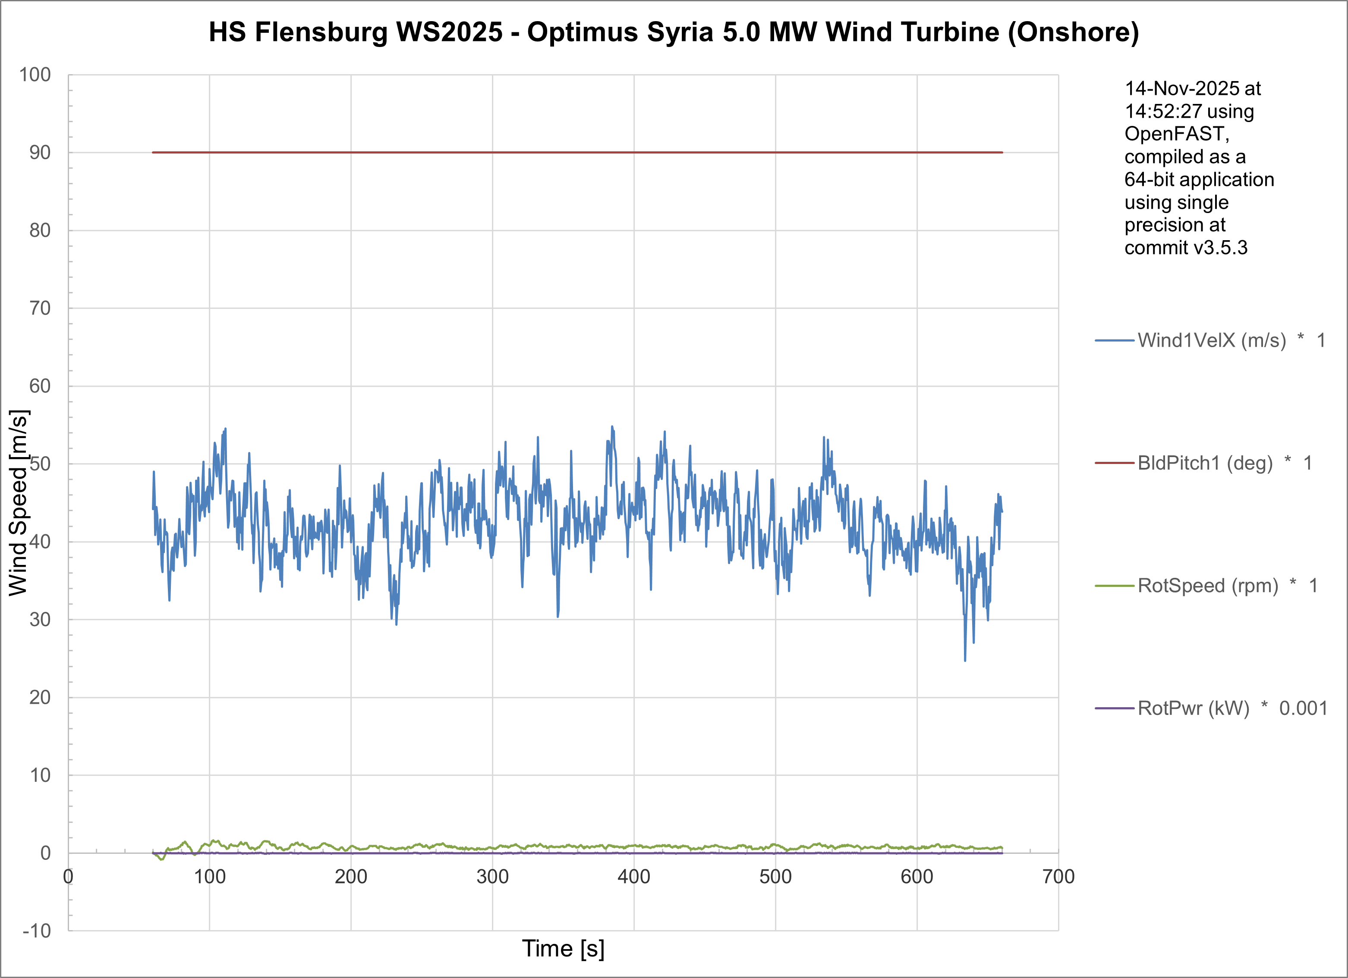
DLC 6.1With Different Randseed
DLC 6.1 requires the turbine to be running in a standby or parked condition (i.e., not producing power but ready to operate) when it is hit by a turbulent wind field where the mean speed is the 50-year extreme wind speed.
42.5 m/s
18/11/2025
9
Md Aman, Arham Memon, Paresh Nakum
Load & Dynamics Team/ Optimus Syria

Slide 10
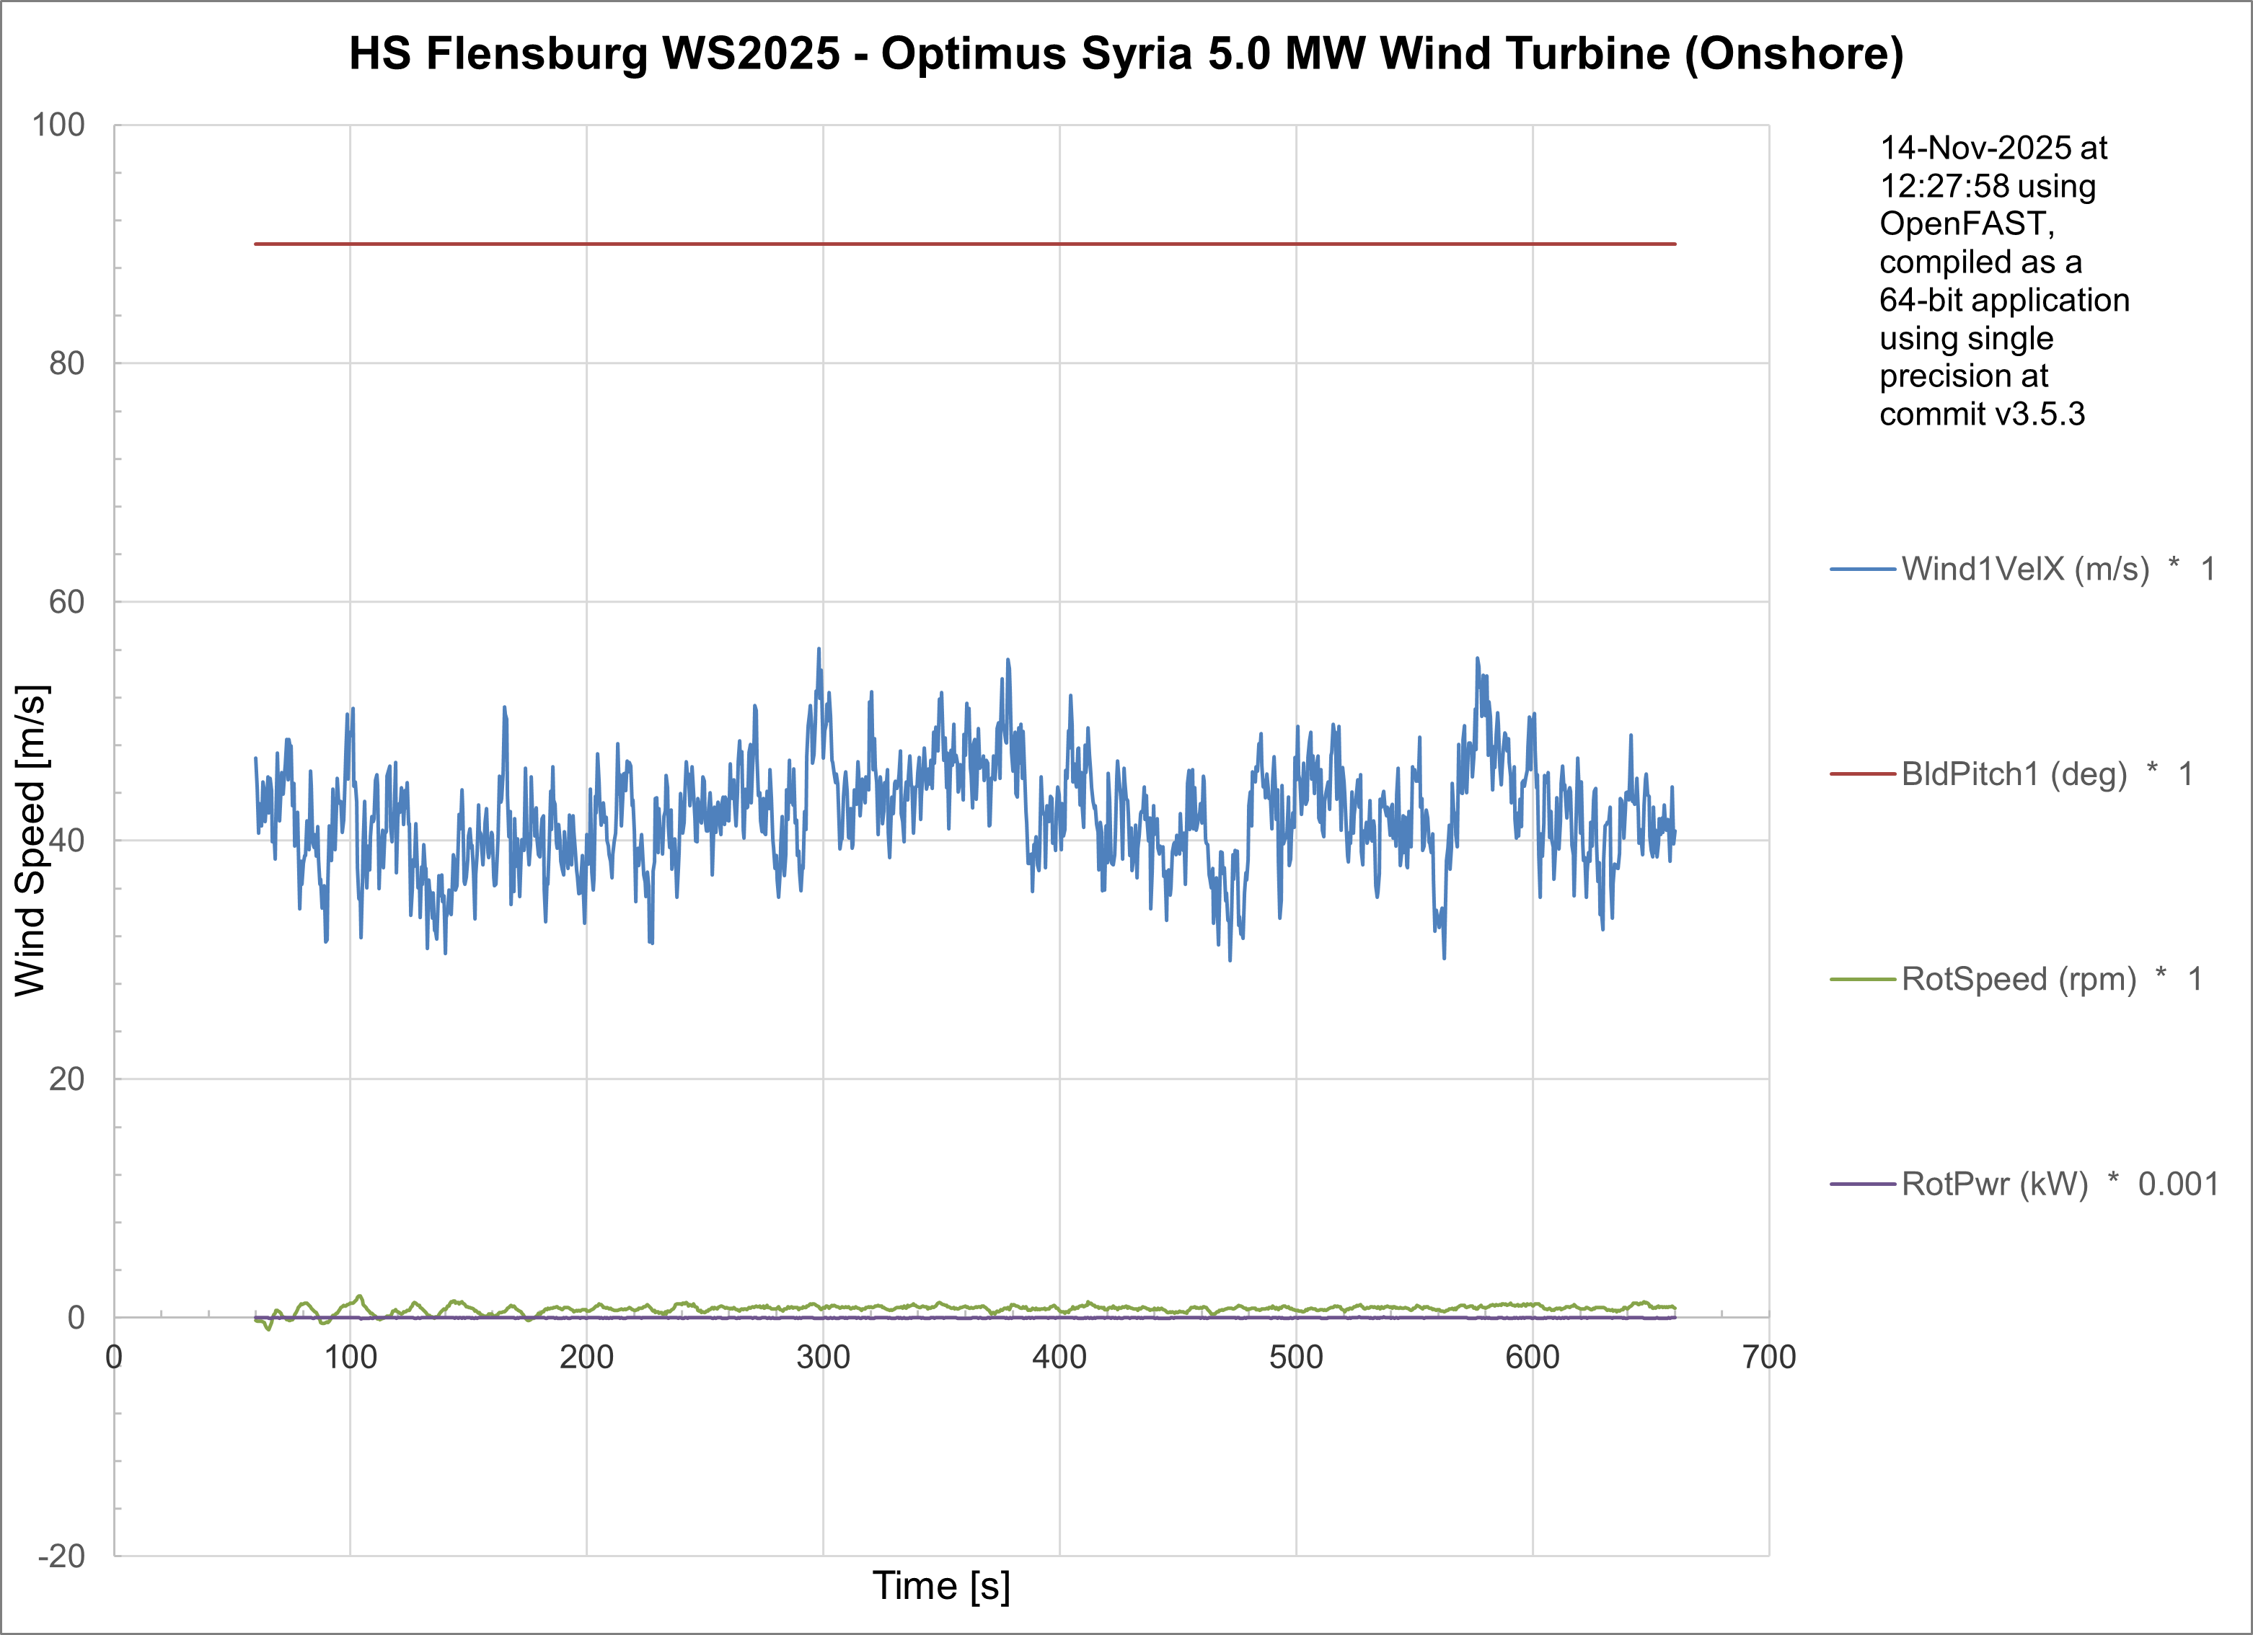
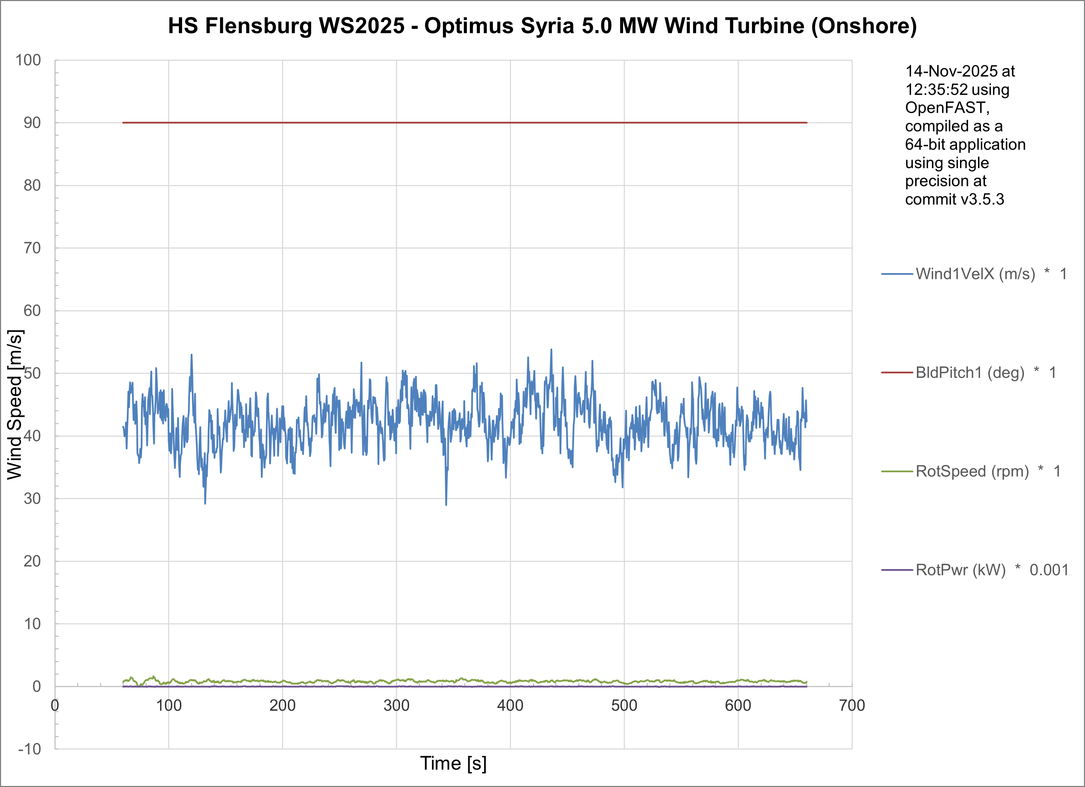
DLC 6.1With Different Randseed
42.5 m/s @ 10 seed
42.5 m/s @530 seed
18/11/2025
10
Md Aman, Arham Memon, Paresh Nakum
Load & Dynamics Team/ Optimus Syria

Slide 11
DLC 6.1With Different Randseed
42.5 m/s @-5221 Seed
The use of different random seeds is mandatory for DLC 6.1 EWM because it generates unique realizations of the extreme turbulent wind field. Since maximum structural loads depend critically on the unpredictable timing and spatial distribution of the largest gusts hitting the rotor, running multiple seeds guarantees that the worst-case load combination is found. This process provides the statistical confidence required by certification bodies to define the ultimate load envelope of the turbine.
18/11/2025
11
Md Aman, Arham Memon, Paresh Nakum
Load & Dynamics Team/ Optimus Syria

Slide 12
Conclusion & Future Plan
In the last week we
Configured Wind Simulations for DLC 4.2
Update Simulation with DLC 5.1
Analyzed DLC 6.1 with different random seed cases (different turbulent wind pattern)
Provided forces and moments at different section of turbine to other teams
In the next week
Simulate OpenFAST for updated parameter of turbine
Configure Simulation with other DLC Cases
Work with different groups
Start Calculation of MExtremes
18/11/2025
12
Md Aman, Arham Memon, Paresh Nakum
Load & Dynamics Team/ Optimus Syria

Slide 13
References
Load Reports of the OPTIMUS projects
GL Guideline for the Certification of Wind Turbines Edition 2010
Standard, DNVGL-ST-0376 – Edition December 2015
IEC 61400-1 2019-02, Ed. 4.0/ DNVGL-ST-0437 Loads and site conditions for wind turbines 11-2016
TurbSim, OpenFAST & NREL 5 MW
18/11/2025
13
Md Aman, Arham Memon, Paresh Nakum
Load & Dynamics Team/ Optimus Syria

